Slide 1
Fluctuating Power Logic: SCA Protection By V_{DD} Randomization At The Cell-level
Fan Zhang, Bolin Yang, Bojie Yang, Yiran Zhang, Shivam Bhasin, Kui Ren
Notes:
This work is going to propose a Fluctuating Power Logic. This is a joint work done by my tutor Fan Zhang and my classmates in Zhejiang University.

Slide 2
Content
Introduction

Slide 3
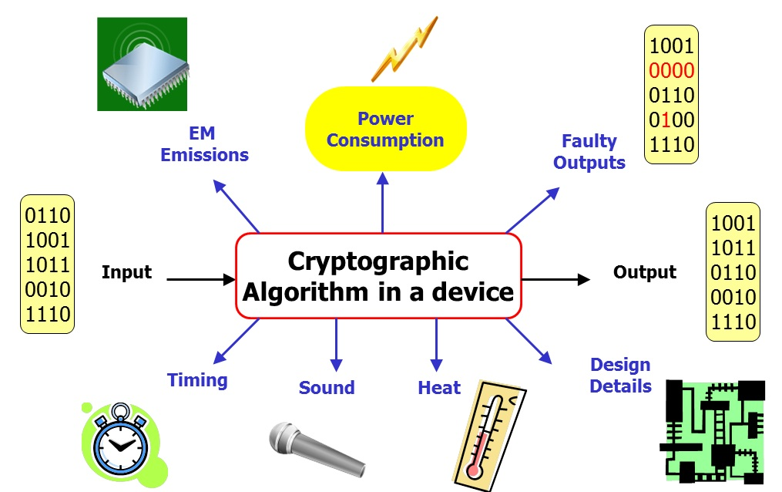
Introduction
Side-Channel Analysis
Power dissipation correlates to switching operations

Slide 4
Mainstream SCA countermeasures
Hiding :noise, clock randomizer, dual-rail precharge logics
Masking: algorithm level, hardware level

Slide 5
New countermeasure
Notes:
The masking and hiding is used to remove the dependence of the two parts.
Our work aims to remove the correlation between key-dependent data and power dissipation directly, regardless of whether the power model is known to the adversary.

Slide 6
Our contributions
We propose a novel cell-level logic: Fluctuating power logic(FPL
We analyzed side-channel security on PRESENT/AES implementation
We compared FPL with standard-cell-based and WDDL-based implementation

Slide 7
FPL
This scheme is based on a cascade voltage logic(CVL) and further enhanced with a compensatory unit (CU).

